Slide 1





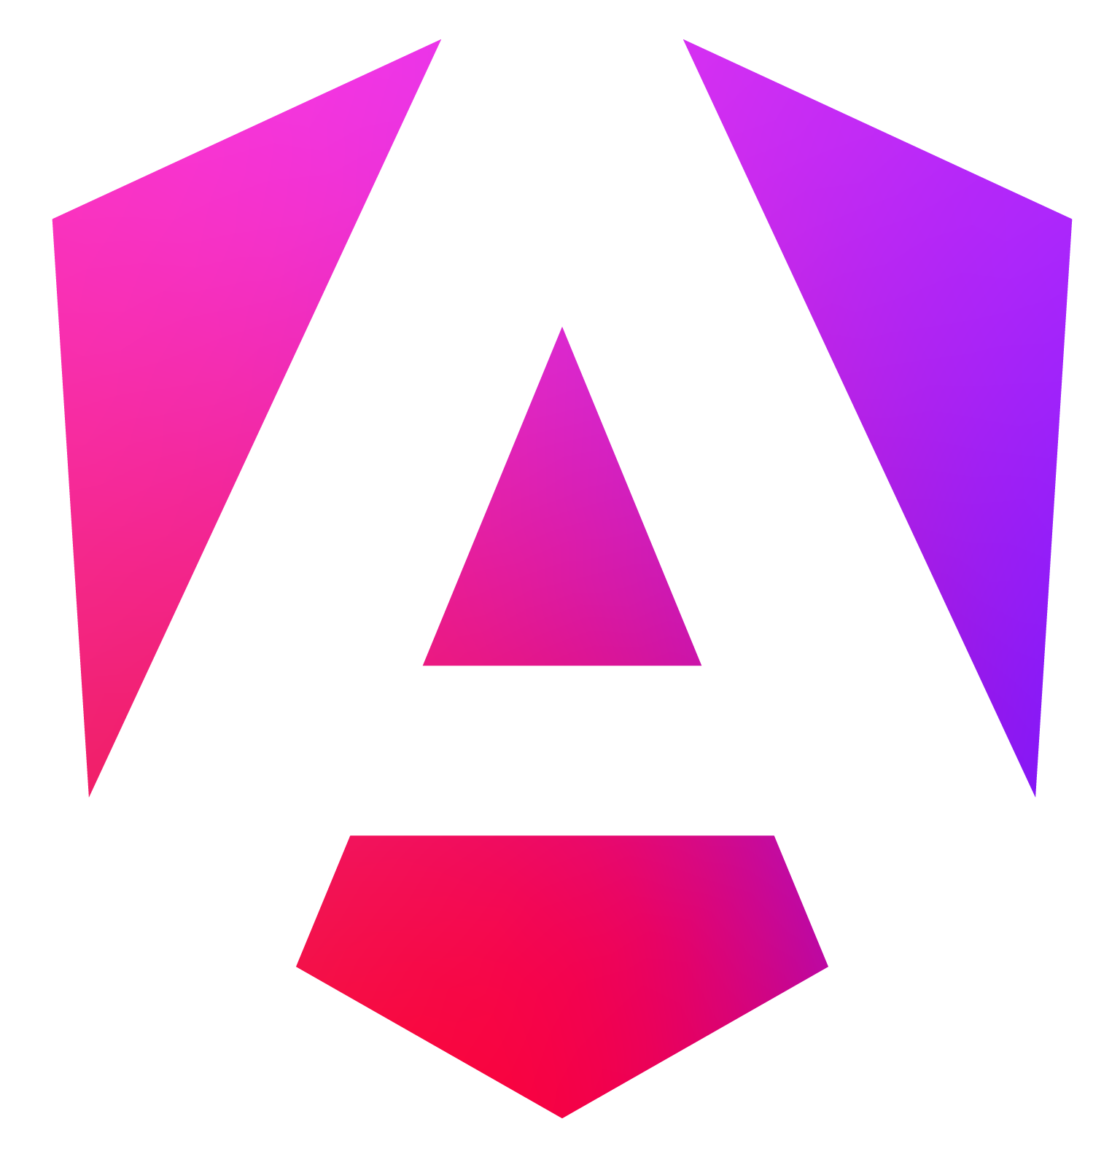











Interactive Map of SETU Carlow Gábor Major
2024-12-06 Supervisor: Dr Oisin Cawley
Abstract
As the name implies this project is an
interactive map of the SETU Carlow campus, including the buildings and rooms. It allows for any guests and new students coming to the campus to easily find their way around the college grounds.
The application allows not just the finding of buildings but also giving routes inside allowing people to find a specific room they are looking for.
2) Frontend
There is an abundance of different types of frontend libraries and programs available, some are more suitable for a wide range of platform development like Java, a cross platform general programming language, while others are specific to one platform like Angular, a framework for web applications.
As the platforms were decided to be an Android and a Web Application, the best tool for the frontend would be one which allowed the easy exportation of the project to both platforms.
The following common development frameworks were compared across the following headings:
Native Web App – Whether exporting as a native Web App is available.
Native Android App – Whether exporting as a native Android App is available.
Same Codebase – Whether the same code can be used for the 2 different exports.
Simple 3D Rendering – Whether some basic 3D rendering is easily available.
Lightweight – Mixture of configuration complexity, framework IDE size, runtime resource requirement.
Ultimately after researching frameworks the Godot game engine was chosen as the development framework for the frontend of the interactive map. It allows natively for exporting to Web and Android, the code can be reused for both exports, it has simple 3D capabilities and is easy to setup, develop in and export from.
5) Admin Portal
Finally the Admin Portal part of the system which is used to edit the map data is going to be available as part of the Web App.
This allows that all of the code to be reused for showing the map and connections used to connect to the backend data storage.
It also allows for a bigger
interface compared to the
android app.
Development Framework
 | Java | Kotlin | Flutter | Angular | Unreal Engine | Unity | Godot
Native Web App | ✓ | ✓ | ✓ | ✓ | ✗ | ✓ | ✓
Native Android App | ✓ | ✓ | ✓ | ✗ | ✓ | ✓ | ✓
Same Codebase | ✗ | ✓ | ✓ | ✗ | ✗ | ✓ | ✓
Simple 3D Rendering | ✗ | ✗ | ✗ | ✗ | ✓ | ✓ | ✓
Lightweight | ✗ | ✗ | ✓ | ✗ | ✗ | ✗ | ✓
Introduction
This poster takes a look at the various technologies used for the whole project and the reasons for using the technologies.
A list of technologies required for the success of the project include:
Platforms – Target devices to run on.
Frontend – Displaying the map.
Pathfinding Algorithm – Navigating the map.
Backend – Storing the map data.
Admin Portal – Editing the map data.
Important things to keep in mind when choosing technologies are the following:
The application should be quick and
easy to use.
Furthermore the app should be as
accessible to most people coming
to the college.
Finally the application should be
able to work offline, as guests
may not have an internet
connection in the college.
Summary
With the research laid out by the
poster the following technologies
were decided to be used for the project.
The primary platform will be for Android, with a secondary Web App.
The application will be created using the Godot game engine.
A* Algorithm will be used for the pathfinding giving high performance.
A Firebase storage instance will be used as a backend for storing map data.
The Admin Portal for editing the map data will be available in the Web App.
4) Backend
The backend for the system is used to store
map data files. It is needed so that the
application can update the map data
independently at each start up.
The chosen backend was Firebase as it
has the ability to store custom files, is a
popular program with documentation,
and has a Godot plugin available that
is actively being maintained.
3) Pathfinding Algorithm
The pathfinding algorithm is a crucial aspect of the project as it is what the main use case is for. As the map is static while using it, the following 4 algorithms were looked at.
*Complexity and Performance are given relative to each other.
Depth First Search / Breadth First Search
Both Depth First Search and Breadth First Search are simple algorithms that are useful if you have no information about the medium you are traversing or searching.
They however lack behind in performance when information about the start and end positions or distances between sections in known. [2, 3]
Dijkstra’s Algorithm
Dijkstra’s Algorithm is a bit better in terms of performance as the distance to other nodes is taken into consideration, it always strives for the
shortest path.
It does not use the start and end positions though and lacks behind
in getting closer to the target. [4]
A* Algorithm
The A* Algorithm is the one going to be used in
the application as it is the best in this scenario.
It takes into consideration not just the distance
between 2 nodes but also the positions of the start
and end nodes, giving it a boost in performance over Dijkstra’s Algorithm. [5]
1) Platforms
The best platform to have a mapping application on is a mobile phone, as you are able to use the map while
you are traversing the campus. Throughout
Ireland the most common mobile operating
system is Android followed by iOS. [1]
However creating an application for only Android
would not allow about 40% of people to use the
application at all.
Thus a HTML5 Web Application was also chosen
as a platform, to allow non Android and desktop
users access to the map.
 | Complexity* | Performance* | Information Used
Depth First Search / Breadth First Search | Low | Slow | None
Dijkstra’s Algorithm | Medium | Medium | Traversing Cost
A* Algorithm | High | Fast | Traversing Cost, Distance to Target
Appendix
The A* Algorithm is a pathfinding and graph traversal heuristic algorithm to efficiently plot the shortest route between 2 nodes on a graph. [5]
Technologies Mentioned
Android – https://www.android.com/
IOS – https://www.apple.com/ios/
HTML5 – https://html.spec.whatwg.org/multipage/
Java – https://www.java.com/en/
Kotlin – https://kotlinlang.org/
Flutter – https://flutter.dev/
Angular – https://angular.dev/
Unreal Engine – https://www.unrealengine.com/en-US
Unity – https://unity.com/
Godot – https://godotengine.org/
Firebase – https://firebase.google.com/
Bibliography
[1] StatCounter (2024) Mobile Operating System Market Share Ireland. Available at: https://gs.statcounter.com/os-market-share/mobile/ireland (Accessed: 23 October 2024)
[2] Brilliant.org (2024) Depth-First Search (DFS). Available at: https://brilliant.org/wiki/depth-first-search-dfs/ (Accessed: 23 October 2024)
[3] Brilliant.org (2024) Breadth-First Search (BFS). Available at: https://brilliant.org/wiki/breadth-first-search-bfs/ (Accessed: 23 October 2024)
[4] Brilliant.org (2024) Dijkstra's Shortest Path Algorithm. Available at: https://brilliant.org/wiki/dijkstras-short-path-finder/ (Accessed: 23 October 2024)
[5] Brilliant.org (2024) A* Search. Available at: https://brilliant.org/wiki/a-star-search/ (Accessed: 23 October 2024)
Generic Icons
Flaticon – https://www.flaticon.com/
Glossary
SETU – South East Technological University
App – Application
IDE – Integrated Development Environment
A* – A star

